Slide 1
Welcome!

Slide 2
New Otters
Fall & Winter 2024

Slide 3
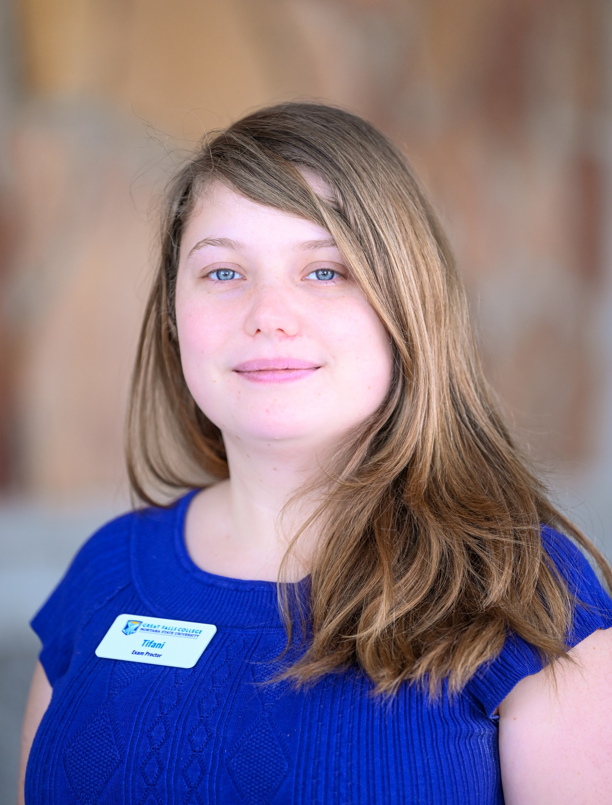
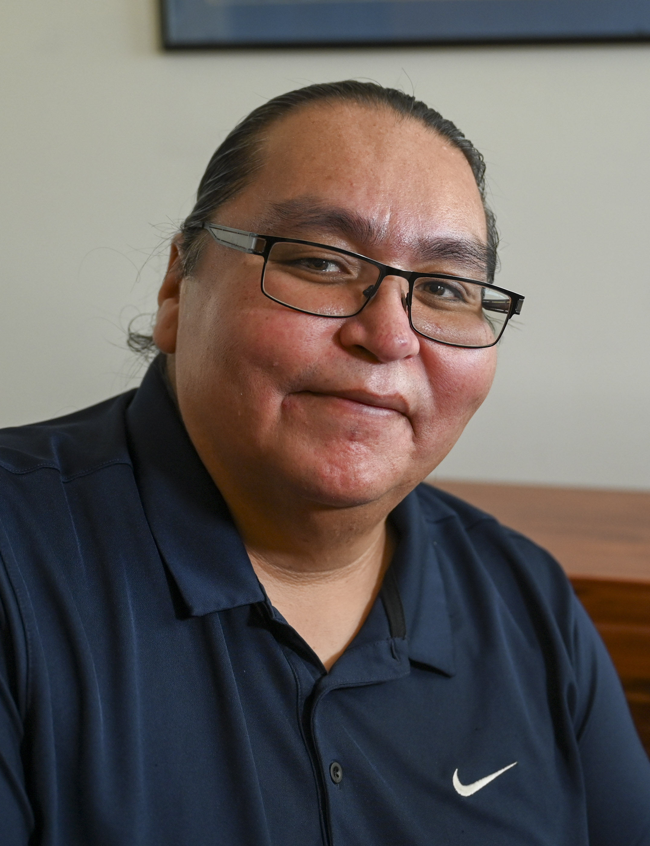
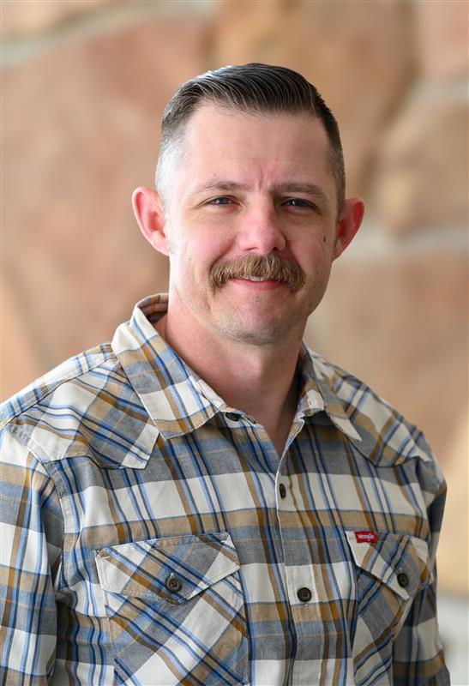
Academic & student support
Tifani Crawford-Barsotti
Exam Proctor
Calvin Gone
Native American Student Ambassador
Chris Sawhill
Veteran’s Success Coach

Slide 4
General Studies & ADJUNCTS
Robert Ingram
CET Healthcare
Karl Berg
Welding
Sarah Ginger
Dental Hygiene
Carl Clary
Nursing
Jennifer Wendland
Biology Lab Instructor

Slide 5
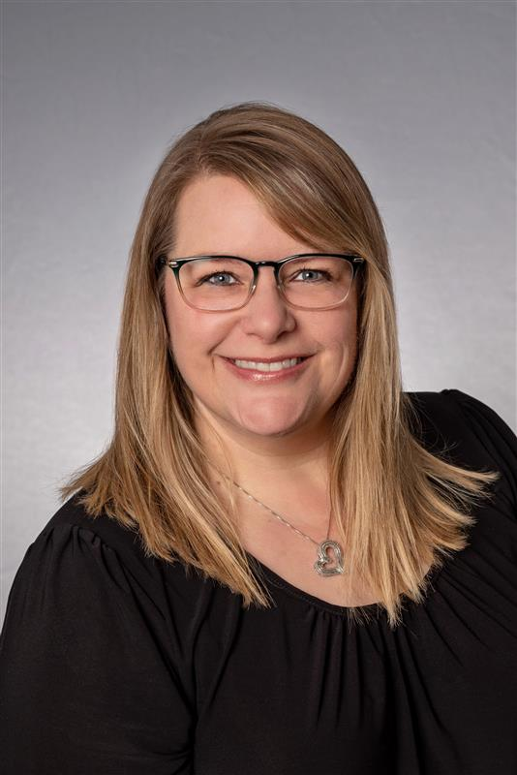
ADMINISTRATION
Amy Thompson
Executive Director
GS 10K SB

Slide 6
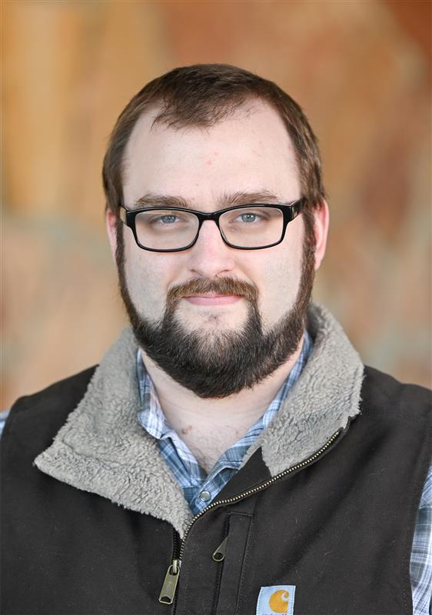
Same Otter, different den
Kody Gilleo
Computer Support Specialist

Slide 7
Website
Update
Scott Thompson

Slide 8
Mental
Health Resources
Troy Stoddard

Slide 9
Institutional Accreditation
Mid-Cycle Report and Visit
Eleazar Ortega, Accreditation Liaison Officer

Slide 10
What is Institutional Accreditation?
A voluntary peer review process that assesses the quality of a college.
It evaluates all aspects of the institution– academic programs, governance, administration, mission, finances, and resources.
Accreditation provides public assurance about the quality of an institution and gives it a way to evaluate itself and improve.
Provides us with the ability to provide Title IV federal financial aid to students, transfer and accept student transcripts and credits, and increase the likelihood of degree acceptance from employers and other higher education institutions.

Slide 11
Northwest Commission on Colleges and Universities (NWCCU)
NWCCU is a Washington State nonprofit corporation, recognized as a 501(c)(3) organization by the Internal Revenue Service.
NWCCU is recognized by the United States Department of Education (USDE) as an accreditor of higher education institutions throughout the United States.
The overriding purpose of NWCCU accreditation is to assure stakeholders that an NWCCU-accredited institution has been rigorously evaluated and that it meets or exceeds the criteria required to maintain accreditation. In addition, NWCCU promotes a culture of data- and evidence-informed continuous institutional improvement.

Slide 12
Institutional Accreditation Report and Visits Schedule
Year 1 (2023)– Annual report
Year 2 (2024)– Annual report
Year 3 (2025)– Annual report + Mid-Cycle Self-Evaluation report and visit
Year 4 (2026)– Annual report
Year 5 (2027)– Annual report
Year 6 (2028)– Annual report + Policies, Regulations, and Financial Review report
Year 7 (2029)– Annual report + Evaluation of Institutional Effectiveness report & visit

Slide 13
Mid-Cycle Self-Evaluation Report and Visit
Report due approx. February 20, 2025
Visit will be April 3-4, 2025 (Thursday and Friday)
During the visit, the following areas will/may be involved:
Academic Advisors
Administrative Unit Review committee
Division Directors
Executive Council
Facilities
Human Resources
Internal Academic Program Review committee
Library
Office of Institutional Effectiveness
Strategic Analysis and Reporting committee
Student Learning Assessment committee
Student Services Directors
Teaching and Learning Center

Slide 14
Employee Satisfaction
Survey
Dr. Stephanie Erdmann

Slide 15
College Employee Satisfaction Survey (CESS)
Fall 2024
33% Response Rate
207 were invited responded to the survey, N=68
NOTE: Response rate declined from 52% in 2022

Slide 16
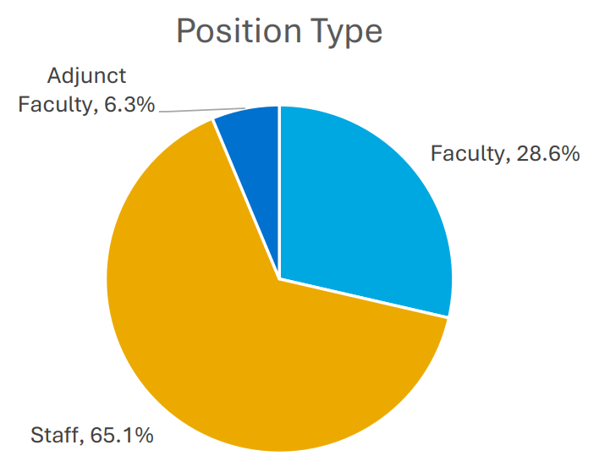
94% Full Time

Slide 17
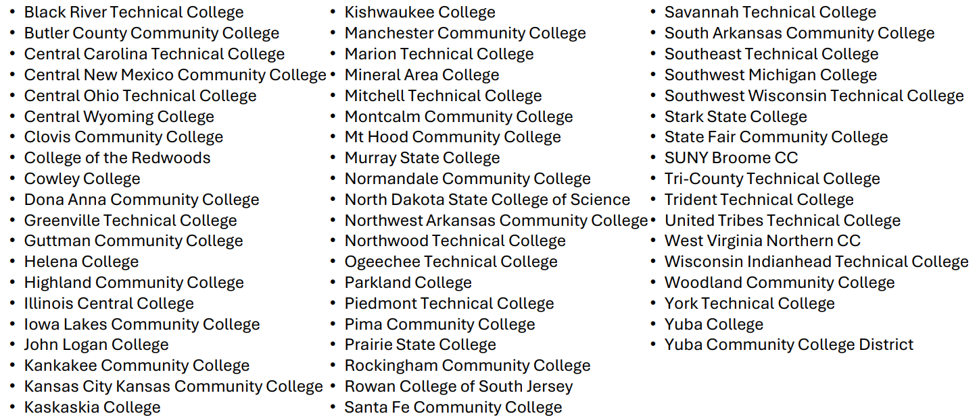
Comparison Group
57 Other Two Year Public Institutions

Slide 18
Intended Outcome:
Overview of and reflection on the results.
Survey overview
Great Falls College’s strengths
Priorities for improvement
Views on goals and planning
Your reflections

Slide 19
Four Areas
Campus Culture and Policies
Work Environment
Institutional Goals
Involvement in Planning

Slide 20
Satisfaction
Importance
Gap

Slide 21
Very Important
Challenges
Strengths
Very Unsatisfied
Very Satisfied
Very Unimportant

Slide 22
Strengths
We take pride in our work
We prioritize our students
We feel respected, valued, and have a safe work environment
TO NOTE:
On all comparison items with a statistically significant difference, Great Falls College employees were more satisfied than the comparison group.

Slide 23
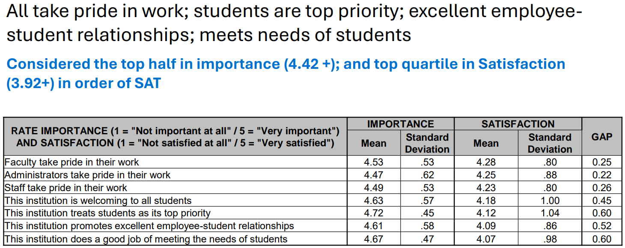
Details-Campus Culture

Slide 24
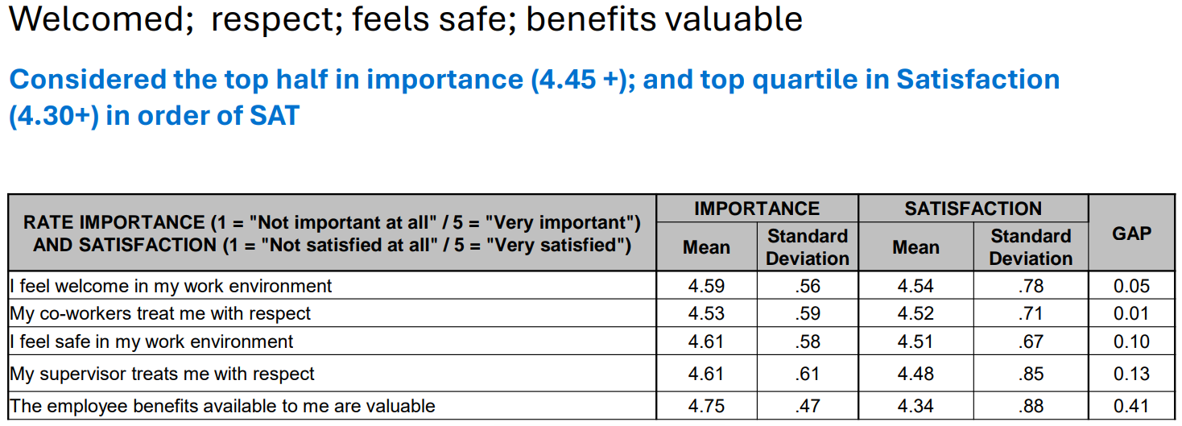
Details-Work Environment

Slide 25
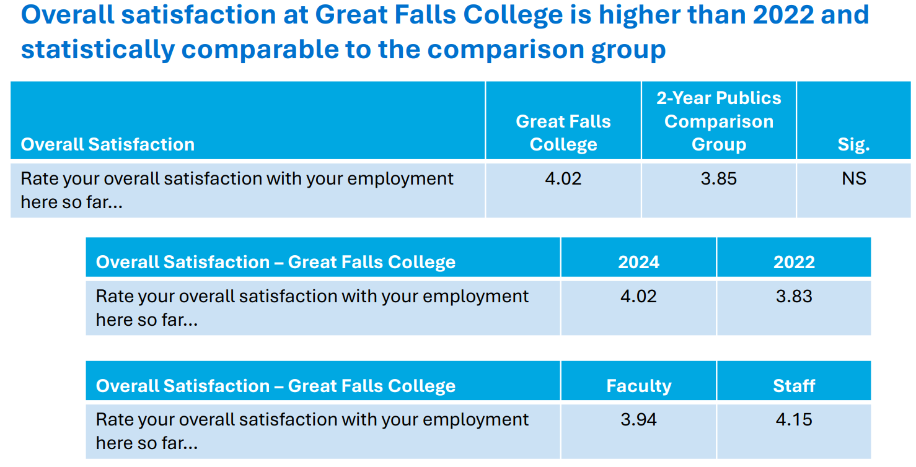
Overall Satisfaction

Slide 26
Challenges-Priorities
We can continue to work on cross-departmental communication
We can better engage employees in planning
We can provide staff and budgetary resources
We can continue to work on pay, professional development, and advancement strategies

Slide 27
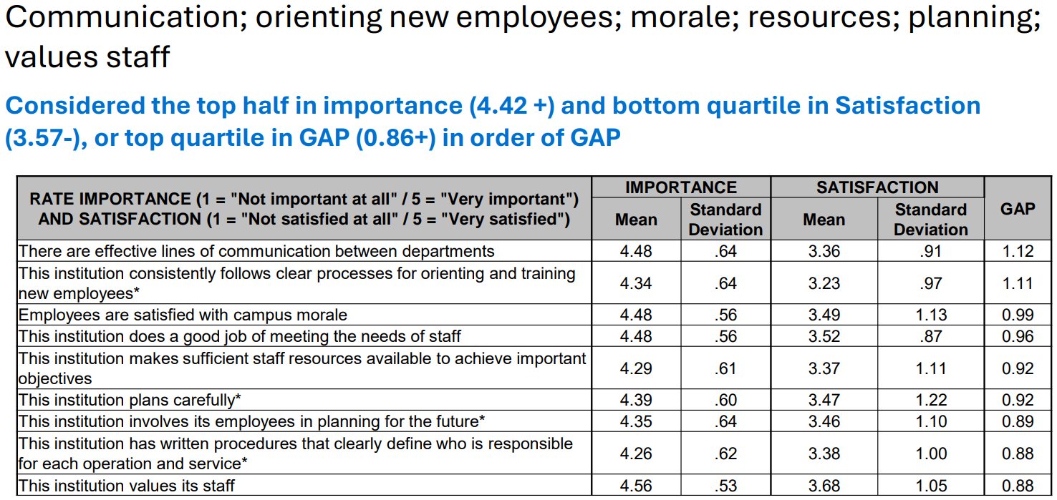
Campus Culture

Slide 28
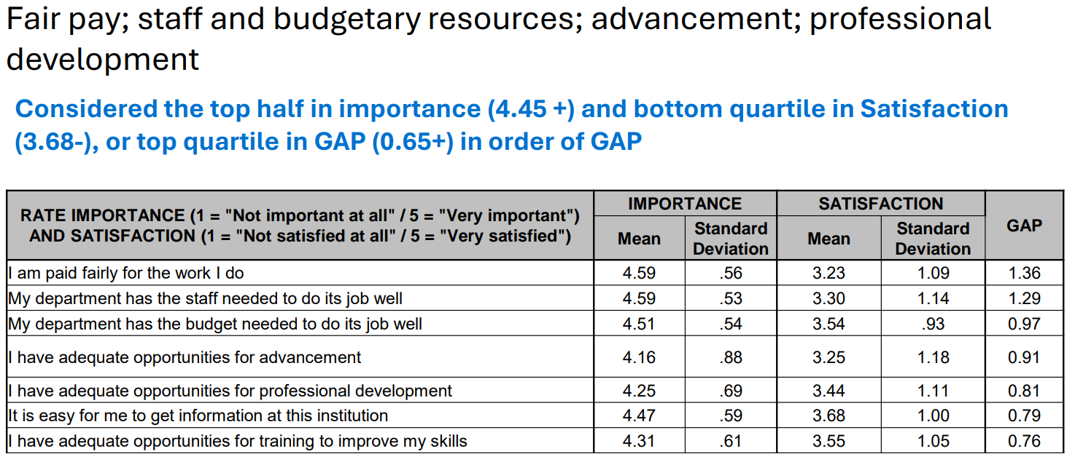
Work Environment

Slide 29
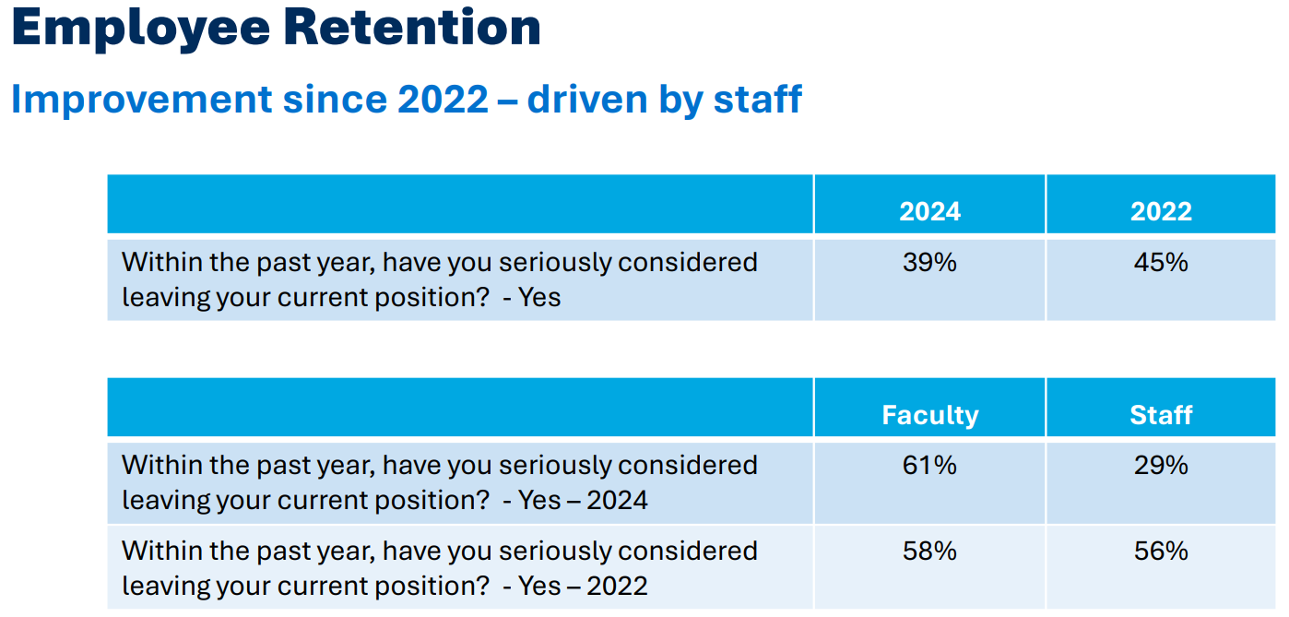
Improvements Made

Slide 30
Comparison
Employee retention and morale continue to be top goals
Increasing enrollment and developing/improving academic programs less important than comparison group.

Slide 31
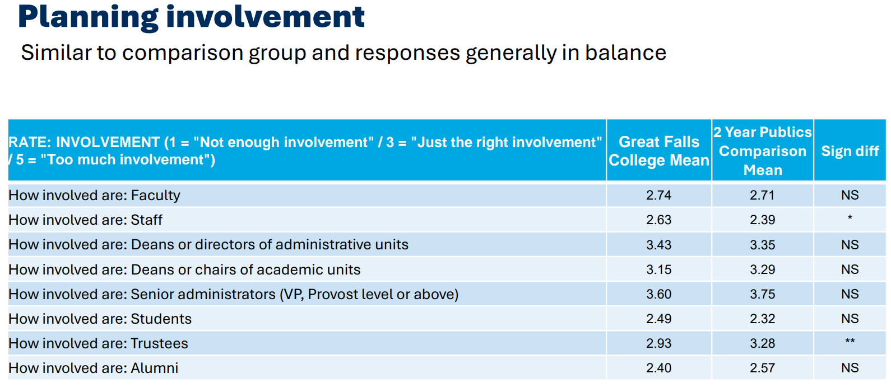
Comparison

Slide 32
Employee Reflections

Slide 33
Please download and install the Slido app on all computers you use
Which of these 3 identified priorities from the survey should be the focus for 2025?
ⓘ Start presenting to display the poll results on this slide.

Slide 34
What will we do with the results?
Post the quantitative data in the College Council folder.
Set up a team to address the 2025 priority identified today.
Communicate progress through College Council and The Otter News.
Other ideas?

Slide 35
Student
Panel
Scott Thompson

Slide 36
Wrap
Up
Quincie Jones

